Slide 1

STATS 432 Computational Statistics
Tutorial 4 – Markov Chains

Slide 2

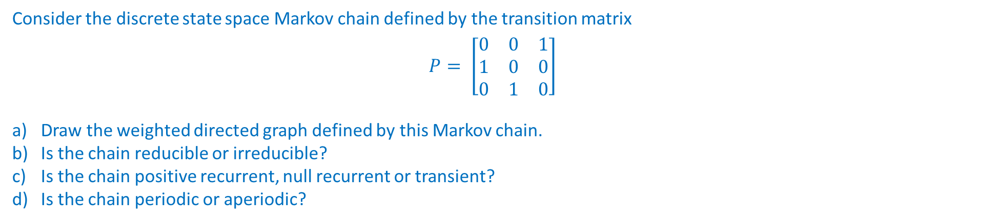
Question 1 :
Question 1
Consider the discrete state space Markov chain defined by the transition matrix
$$P= \left[\begin{matrix}0 & 0 & 1 \\ 1 & 0 & 0 \\ 0 & 1 & 0\end{matrix}\right]$$
Draw the weighted directed graph defined by this Markov chain.
Is the chain reducible or irreducible?
Is the chain positive recurrent, null recurrent or transient?
Is the chain periodic or aperiodic?
2

Slide 3
Question 2:
Question 2
Consider the discrete state space Markov chain defined by the weighted directed graph shown below
1
Write out the transition matrix defined by this Markov chain.
Is the chain reducible or irreducible?
State whether each communication class is positive recurrent, null recurrent or transient?
State whether each communication class periodic or aperiodic?
5
2
4
3
6
7
3

Slide 4
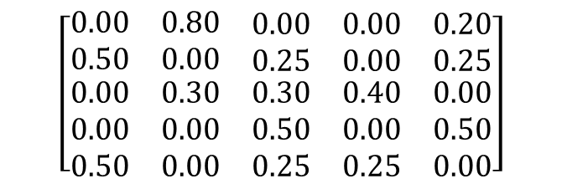

Question 3:
Question 3
0.5
1
0.8
Consider the discrete state space Markov chain defined below
0.2
0.5
1
2
3
4
5
5
2
0.25
1
$$\left[\begin{matrix}0.00 & 0.80 & \begin{matrix}0.00 & 0.00 & 0.20\end{matrix} \\ 0.50 & 0.00 & \begin{matrix}0.25 & 0.00 & 0.25\end{matrix} \\ \begin{matrix}0.00 \\ 0.00 \\ 0.50\end{matrix} & \begin{matrix}0.30 \\ 0.00 \\ 0.00\end{matrix} & \begin{matrix}\begin{matrix}0.30 \\ 0.50 \\ 0.25\end{matrix} & \begin{matrix}0.40 \\ 0.00 \\ 0.25\end{matrix} & \begin{matrix}0.00 \\ 0.50 \\ 0.00\end{matrix}\end{matrix}\end{matrix}\right]$$
2
0.25
0.3
$$P=$$
3
0.25
0.25
4
5
0.5
4
3
0.4
0.3
What conditions ensure that a discrete state space Markov chain has a stationary distribution? Are these conditions satisfied here? If so, find the stationary distribution.
What conditions ensure that a discrete state space Markov chain has a limiting distribution? Are these conditions satisfied here?
Given your answer to the above, give an expression for $\lim_{n →∞}{P\left( X^{\left(n\right)}=j \right)}$ for each $j=1, …, 5$
Give an expression for $\lim_{n→∞}{P^{n}}$. Check your answer by raising the matrix $P$ to successively higher powers in R.
4
Associated code = Tutorial 4 – Q3

Slide 5
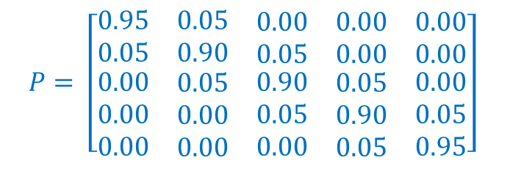
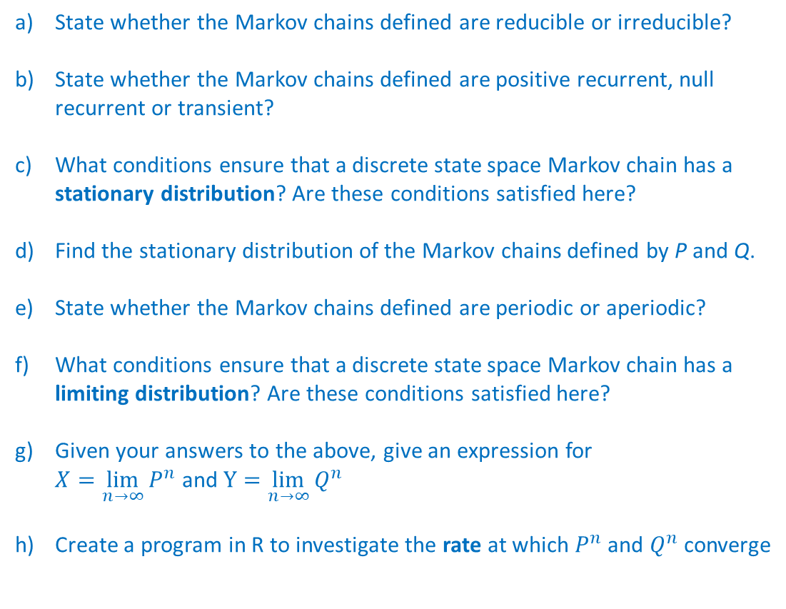
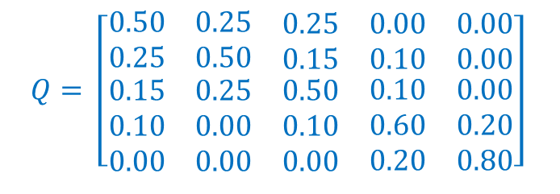
Question 4:
Question 4
Consider the following discrete state space Markov chains defined by the following transition matrices
State whether the Markov chains defined are reducible or irreducible?
State whether the Markov chains defined are positive recurrent, null recurrent or transient?
What conditions ensure that a discrete state space Markov chain has a stationary distribution? Are these conditions satisfied here?
Find the stationary distribution of the Markov chains defined by P and Q.
State whether the Markov chains defined are periodic or aperiodic?
What conditions ensure that a discrete state space Markov chain has a limiting distribution? Are these conditions satisfied here?
Given your answers to the above, give an expression for $X=\lim_{n→∞}{P^{n}}$ and $Y=\lim_{n→∞}{Q^{n}}$
Create a program in R to investigate the rate at which $P^{n}$ and $Q^{n}$ converge
$$P= \left[\begin{matrix}0.95 & 0.05 & \begin{matrix}0.00 & 0.00 & 0.00\end{matrix} \\ 0.05 & 0.90 & \begin{matrix}0.05 & 0.00 & 0.00\end{matrix} \\ \begin{matrix}0.00 \\ 0.00 \\ 0.00\end{matrix} & \begin{matrix}0.05 \\ 0.00 \\ 0.00\end{matrix} & \begin{matrix}\begin{matrix}0.90 \\ 0.05 \\ 0.00\end{matrix} & \begin{matrix}0.05 \\ 0.90 \\ 0.05\end{matrix} & \begin{matrix}0.00 \\ 0.05 \\ 0.95\end{matrix}\end{matrix}\end{matrix}\right]$$
$$Q= \left[\begin{matrix}0.50 & 0.25 & \begin{matrix}0.25 & 0.00 & 0.00\end{matrix} \\ 0.25 & 0.50 & \begin{matrix}0.15 & 0.10 & 0.00\end{matrix} \\ \begin{matrix}0.15 \\ 0.10 \\ 0.00\end{matrix} & \begin{matrix}0.25 \\ 0.00 \\ 0.00\end{matrix} & \begin{matrix}\begin{matrix}0.50 \\ 0.10 \\ 0.00\end{matrix} & \begin{matrix}0.10 \\ 0.60 \\ 0.20\end{matrix} & \begin{matrix}0.00 \\ 0.20 \\ 0.80\end{matrix}\end{matrix}\end{matrix}\right]$$
5
Associated code = Tutorial 4 – Q4

